Slide 1
PP Jam PHN Alert
Sep/07/2019

Slide 2
Old PHN Alert
2 PHN alerts based on 5756 retries: 1 for Rxn Disc and 1 for Pretreatment
Flags if PP (main disc or pretreatment) had more than 8 PP retries (5756) in a day
The PHN was a good predictor of fatal errors (5757 errors) and issues in PP
SW was changed to change the criteria of 5757 fatal errors to reduce # of fatal errors that the customer experience although there are a lot of retries going in the background
New 5757 fatal error flags only when more than 10 retries in 100 reps are recorded
As such our team was asked to update the PHN to make it less sensitive to retries

Slide 3
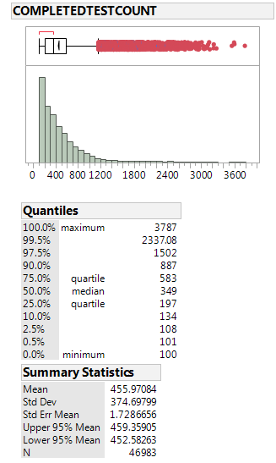
Data Pull by Nirav Soni
From Feb/28/2019 to May/31/2019
1,941 different instruments queried
Queried # tests completed per day & # 5756 retries and # 5757 and 5752 Fatal errors
Fatal errors considered as :
1 Aimcode #5757 in a day
Or 1 Aimcode #5752 with many retries in a day
The old PHN flag would have flagged ~2,000 times ( no repressing rules)

Slide 4
New PP PHN alert
If (# tests completed per day <=400 & # of retries >=20) => Flag
If (# Tests competed per day >400 & # of retries >=35) => Flag
Else => No Flag
For RXN PP: Retries are recorded in Message History table with Aimcode 5756 and subcode D298
For Pretreatment Path: Retries are recorded in Message History table with Aimcode 5756 and subcode D299
# tests completed: From Results table

Slide 5
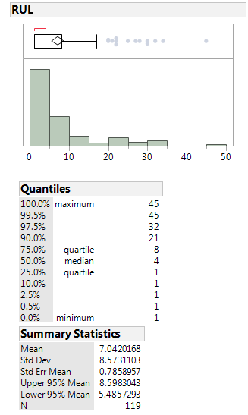

Performance
Fatal Error
Flag
False Alarms where from instruments experiencing very high amounts of retries but because of new 5757 never considered fatal
Excluding Same Day Failures

